Slide 1



CSE 2 • S5 MINOR PROJECT • FINAL REVIEW
AI-Powered Smart Expense Tracker
MoneyTrack AI
TEAM
GUIDE
Akhilesh A
241140110
Ms. Kripa Radhakrishnan
Gokul Sajith
241140129
Assistant Professor - Department of CSE
Vishnu Vijay
241140120
Notes:
Good afternoon, ma’am. Our project is an AI-powered smart expense tracker, we have named it MoneyTrack AI. Our project guide is Kripa Ma’am and we are Akhilesh, Gokul and Vishnu.

Slide 2






Abstract, Purpose and Objectives
WHAT IT IS, WHY WE BUILT IT, WHAT WE AIM FOR
ABSTRACT
WHY WE BUILT IT
Upload your bank statement and the app reads every transaction, uses AI to label it (Food, Bills, Shopping...), and shows it on a dashboard with charts, budgets, goals and savings tips. Unlike apps where you type every expense, ours does it automatically, and you can correct it.
People stop tracking their money because typing every expense is tiring, and bank apps only show a raw list.
AUTOMATE
SECURE
MONITOR
OPTIMIZE
Read and sort statements automatically
Private, per-user dashboard
Budget limits and alerts
AI savings tips and plans
Notes:
Our project allows users to upload bank statements, which are automatically read and categorised into Food, Bills, Shopping and other categories.
The transactions are then displayed on a dashboard with charts, budgets, savings goals and tips.
We built this because manually entering every expense is tiring, so our aim is to make expense tracking automatic, simple and useful.

Slide 3








Existing Tools and Their Gaps
WHAT PEOPLE USE TODAY AND WHAT IS MISSING
WHAT EXISTS TODAY
THE GAPS
Manual tracking apps
You type every entry yourself.
High manual effort
Typing every expense is tiring.
Bank apps
They show a raw list with no meaning.
No automatic categorisation
Every item must be labelled by hand.
Spreadsheets
Slow, and easy to get wrong.
Little personal insight
Numbers are shown, but not explained.
Most existing tools
No statement reading and no AI sorting.
No early warning
Nothing warns you before you overspend.
Notes:
People currently use manual expense trackers, banking apps or spreadsheets to manage their money.
Manual trackers require entering expenses, banking apps mostly show transaction lists, and spreadsheets need manual effort.
The main gaps are manual work, limited spending insights and a lack of early warnings about overspending. These are the problems we wanted to solve.

Slide 4




How We Are Different
COMPARED WITH EXISTING EXPENSE APPS
 | Expense AI | FinArt | Other AI trackers | MoneyTrack AI
Cost | Paid (Rs 260/week) | Free | Free (mostly) | Free
Input method | Manual entry, receipts, chat | SMS-based (automatic) | Manual entry, voice or chat | Upload full bank statement (CSV/PDF)
Historical data | Limited to logged entries | Only from install date onward | None, starts from first log | Entire past history in one upload
Categorisation | AI-based | Rule-based (reads SMS text) | AI on user-typed text | AI (Google Gemini) on real transaction data
WHAT MONEYTRACK AI ADDS
Learns from your corrections
Ask questions in plain English
Savings goals and month-end forecast
Privacy masking (hides account numbers)
Password-protected PDFs
Notes:
Users can upload PDF or CSV bank statements and import their past transactions instead of entering everything manually.
The application learns from category corrections, supports questions in plain English through Montra, and masks sensitive information before sending relevant data to AI.
These features make MoneyTrack AI more than just an expense tracker. Now, Akhilesh will explain how the system works.

Slide 5





System Architecture
HOW THE PARTS OF MONEYTRACK AI FIT TOGETHER
Frontend
React, in the browser
Backend
Spring Boot (Java 21), REST API
MySQL
Database
Security: JWT sign-in check, own data only
Users, transactions, budgets, goals, learned rules and saved AI answers
Login and Register
JPA / SQL
Controllers: receive each request
Upload statement (PDF / CSV)
REST API with JWT token
Statement readers
PDFBox and CSV, into one common format
Categorisation
Your rules, keyword rules, then Gemini AI
Planning and insights
Budgets, goals, forecast, tips, Montra
Gemini AI
Google API
Dashboard and charts
Masked text
Gets masked text only, never full transactions
Ask Montra (chat)
Repositories: save and load data (JPA)
Gmail SMTP
Welcome email
SMTP
Layered design: Controller takes the request, Service does the work, Repository talks to MySQL. The browser never touches the database or the AI directly.
Notes:
This slide shows how the different parts of our application communicate.
The frontend uses React and communicates with the Spring Boot backend through REST APIs.
The backend verifies login tokens and ensures each user can access only their own data.
MySQL stores users, transactions, budgets and goals, while Gemini AI handles selected tasks like categorisation and savings tips.
The browser communicates through the backend, never directly with the database or AI service.

Slide 6




How It Works, Start to Finish
FROM A BANK STATEMENT TO A DASHBOARD
1
2
3
4
5
Upload
Read
Sort
Save
Show
PDF or CSV. Even password-protected PDFs work: the app asks for the password.
Both file types become one common format. For PDFs, money in vs money out is worked out from the running balance. CSV handles different column layouts and date formats.
Three layers: your saved corrections first, then built-in keyword rules, and only what is left goes to Google Gemini AI (it also finds the merchant name). If AI is busy, the app retries, then marks items "Uncategorized" so you can edit them.
Duplicates are skipped if the same statement is uploaded twice. Sensitive parts of descriptions are masked before saving.
The dashboard updates, with a progress bar while the upload runs.
No double counting: if you typed a transaction by hand earlier and it appears in the statement, the app asks "Is this the same payment?" instead of counting it twice.
Notes:
Our workflow has five steps: upload, read, sort, save and show.
The user uploads a PDF or CSV statement, and the application extracts the transactions into a common format.
Categorisation happens in three layers: learned corrections, keyword rules, and finally Gemini AI for the remaining transactions.
The transactions are saved, and the dashboard updates with the results.
Duplicate checks prevent re-uploaded transactions from being counted twice. If a manually added expense matches a statement entry, the app flags it as a possible match.

Slide 7
Techniques We Used
THE METHODS BEHIND EACH STEP
1
Reading statements
PDFBox pulls the text out of the PDF, and pattern matching (regex) finds the date, amount and balance. Money in or out is worked out from the running balance. CSV files are read with Commons CSV.
2
Three-layer sorting
Your saved corrections first, then built-in keyword rules, and only the leftovers go to Gemini AI. Account numbers and UPI IDs are masked before anything is sent.
3
Question to search (Montra)
Gemini turns a question into a fixed, checked search. The app runs it on your own data and writes the answer itself, so Gemini never sees your transactions.
4
Checked AI tips
Tips come from a summary of your spending. The code rejects any number that is not in that summary. Answers are saved (cached), with a backup if AI is down.
5
Plain maths, no AI
Forecast, savings goals, budget suggestion, recurring bills and unusual charges use averages and medians of your past months, so every result can be explained.
Notes:
We use PDFBox to extract text from PDF statements and pattern matching to identify dates, amounts and balances.
Categorisation follows three layers: learned corrections, keyword rules and finally Gemini AI for the remaining transactions.
We validate AI-generated results before using them.
For Montra, questions are converted into structured searches that our backend runs on the user's data.
Finally, budgets, forecasts and savings goals use mathematical calculations based on previous transactions, not AI predictions.

Slide 8
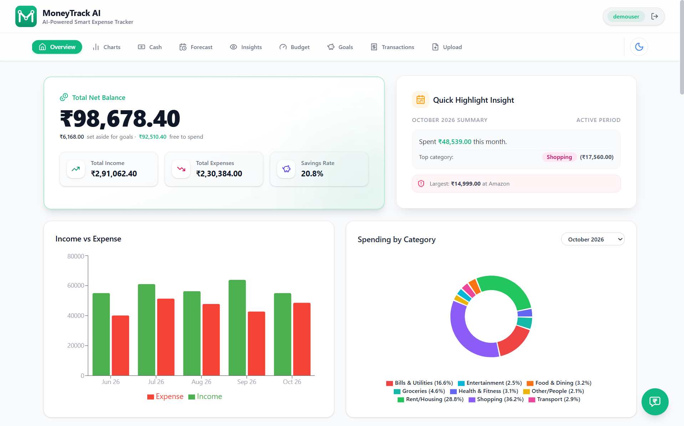





Dashboard and Analytics
YOUR MONEY AT A GLANCE
Overview
Four cards (Total Balance, Income, Expenses, Savings) and an Income vs Expense chart.
Charts
Monthly spending bars and a spending-by-category pie chart, with a month picker.
Transactions
Search, filter by month, grouped by month (latest first), with coloured category tags.
Dashboard overview (demo data)
Extras
Monthly PDF report, light and dark mode, works on phone and tablet, quick navigation bar, loading skeletons (grey placeholders).
Full control
Edit a category or merchant, delete one transaction or a whole month (with confirmation), or add one by hand.
Notes:
The main dashboard displays the balance, income, expenses and savings, with charts for monthly income versus expenses and spending by category.
In the transactions section, users can search, filter, edit categories or merchants, and add or delete transactions.
Users can also delete an entire month's transactions, with confirmation.
Other features include monthly PDF reports, light and dark modes, and support for phones and tablets.
Now, Gokul will explain our AI features and money-planning tools.

Slide 9
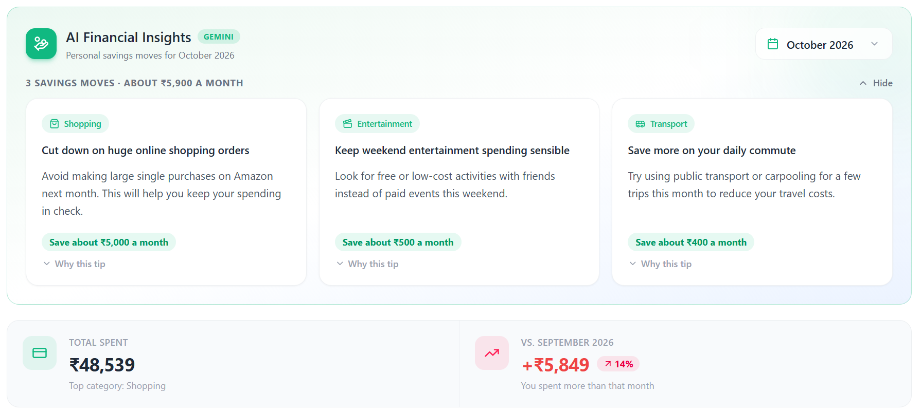


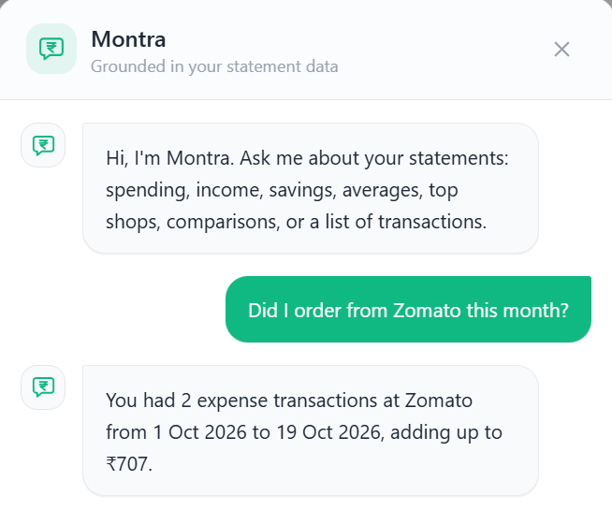


AI Features
WHERE AI HELPS, AND WHERE WE DO THE WORK
Auto categories
Every transaction gets a category and a merchant name, automatically.
Learns from you
Fix a category once and it is remembered. You can view and delete learned rules.
Personal savings tips
3 tips from your own spending, with a "Why this tip" note. Every number is checked first.
Ask Montra
Our assistant. Ask "What were my 5 biggest expenses?" or "Compare this month with last month".
AI savings tips with "Why this tip" (demo data)
Leftover split
Pick a month, see what is left, get a suggested split across goals. 20% always stays free.
Saved results, safe fallbacks
Answers are saved (cached) so AI is not called twice for the same data. If AI is down, each feature has a backup.
WHAT WE BUILT VS WHAT AI DOES
AI only:
1) labels descriptions
2) writes the tip wording
3) turns a question into a simple search
We built everything else: reading statements, rules, all maths and totals, checks on AI output, security, charts and the app. Montra never sees your transactions; the app calculates the answer itself.
Ask Montra (demo data)
Notes:
MoneyTrack AI uses AI for three main tasks: transaction categorisation, savings tip wording, and converting questions into structured searches.
All other tasks, including calculations, security checks, charts and data processing, are handled by our own code.
The application remembers category corrections, so users don't have to correct the same category repeatedly.
Ask Montra doesn't receive the full transaction list. Our backend processes the search and calculates the answer.
We also have fallback mechanisms to keep the application useful when the AI service is unavailable.

Slide 10
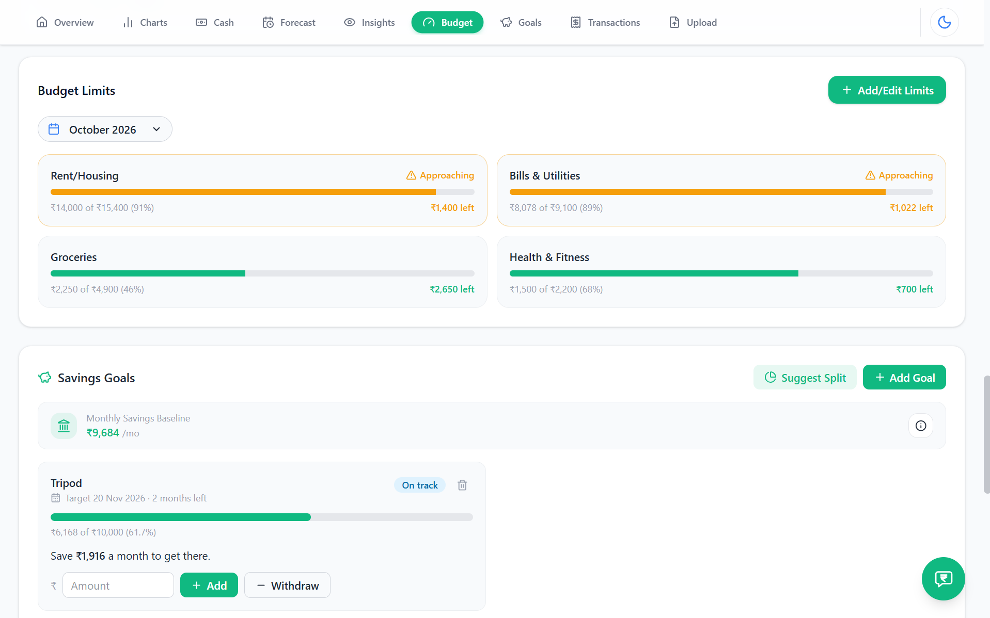




Money Planning Tools
BUDGETS, GOALS, FORECASTS AND INSIGHTS
Budget limits and alerts
Overall and per-category limits with progress bars and "Approaching" or "Over budget" warnings. One click suggests a budget from your last 3 months.
Savings goals
Set a target and date, then add or withdraw money. Shows On track, Behind, Achieved or Overdue based on your usual monthly savings. Handles several goals together.
Budget limits and savings goals (demo data)
Spending insights
What changed vs another month, categories above your average, recurring bills and unusual charges.
Month-end forecast
Predicts whether you will end the month with money left or short.
Cash withdrawals
Split an ATM withdrawal into categories (food, travel...). Totals stay unchanged.
Notes:
Apart from tracking expenses, MoneyTrack AI also helps users plan their finances.
Users can set overall and category-wise budgets, with warnings when spending approaches or exceeds the limits.
Savings goals let users set a target amount and date, track progress, and see whether they're on track or behind.
The month-end forecast estimates whether the user will have money left or fall short.
We also provide insights into spending changes, recurring bills and unusual transactions.

Slide 11



Privacy and Security
WHAT WE PROTECT, AND HOW
Removed before AI
Account numbers, UPI IDs and reference numbers are removed before anything reaches the AI.
Statement file not kept
Your statement file is not kept. We save only the transactions, with sensitive details masked.
Every account is private
Sign-in with secure tokens (a digital pass), and every request only returns that user's own data. Only you can see your data.
You stay in control
Delete one transaction or a whole month (with confirmation), and view or delete the rules the app learned from you.
Note: AI also receives summary information (like category totals) to write tips, never full transaction lists.
Notes:
Since our application handles financial information, privacy and security are important considerations.
Before transaction text reaches Gemini, account numbers, UPI IDs and reference numbers are masked. The original statement file is not stored; only transaction data with sensitive details masked is retained.
We use JWT authentication to protect access and ensure each user can access only their own data.
Users can also delete individual transactions or entire months and view or delete the category rules learned from their corrections.

Slide 12





Technology and How We Built It
OUR TOOLS AND SEVEN WEEKS OF WORK, PLUS WHAT CAME AFTER
BUILD TIMELINE
Backend
Java 21 (programming language), Spring Boot 3.5 (server framework), MySQL (database), Maven (builds the project)
Weeks 1-2
Backend, login and upload
Weeks 3-4
AI sorting, charts, budgets
Frontend
React (builds the screens), Tailwind CSS (styling), Recharts (charts), Axios (talks to the server), jsPDF (makes PDF reports)
Weeks 5-6
Insights, AI tips, full redesign, edit/delete
AI and reading
Google Gemini API (the AI), Apache PDFBox (reads PDFs), Apache Commons CSV (reads CSV files), Gmail email for the welcome mail
Week 7
Dark mode, navigation, 0th review (07/09/2026)
After 0th review
Password PDFs, duplicate check, learned rules, Ask Montra, savings goals, forecast, cash split, PDF reports, welcome email, renamed to MoneyTrack AI, UI polish
Tools
IntelliJ IDEA, VS Code, Postman (tests the server), Git/GitHub (saves and shares the code)
Hardware
Standard PC or laptop, 4 GB RAM, internet connection
How we worked: one module at a time, test each (unit tests and Postman), then test in the browser.
Notes:
As Akhilesh already explained the techniques: our frontend uses React and Tailwind CSS, while the backend is built with Java and Spring Boot.
We use MySQL for the database and Gemini for AI features. We also used tools like Postman for testing and GitHub for version control.
We developed the application module by module, testing each part before integrating everything

Slide 13



Outcomes, Future Work and References
WHAT WE DELIVERED AND WHERE IT GOES NEXT
OUTCOMES (DELIVERED)
FUTURE WORK
REFERENCES
A working full-stack app (screens and server)
Real-time dashboard
Budget alerts and AI tips
Privacy-aware use of AI
Portfolio-ready project
Deployment online (free hosting)
More banks, formats and currencies
Combine statements from several banks
Custom category rules (e.g. "Swiggy over Rs 500 = Weekend Dining")
Excel export
Budget alert emails
Mobile app
Direct bank connection (bank API sync)
[1] P. Sahu et al., "AI Expense Tracker", IJRASET, vol. 13, no. V, May 2025.
[2] P. Animuthu Abishek et al., "Expense Tracker with In-Built AI", IJSRED, vol. 8, no. 2, Mar-Apr 2025.
[3] Spring Boot Documentation, docs.spring.io.
[4] React Documentation, react.dev.
[5] Gemini API Documentation, ai.google.dev.
Notes:
To conclude, we developed MoneyTrack AI as a working full-stack application with automatic expense categorisation, financial dashboards, budget alerts, savings goals and AI-powered insights.
Moving forward, we plan to deploy it online, support more banks and statement formats, add Excel export and develop a dedicated mobile app.
Direct bank integration is another feature we would like to explore in the future.
The references we used throughout the project are listed on this slide.

Slide 14

CSE 2 • MONEYTRACK AI • FINAL REVIEW
Thank You.
Questions and feedback are welcome.
TEAM
GUIDE
Akhilesh A
241140110
Ms. Kripa Radhakrishnan
Gokul Sajith
241140129
Assistant Professor - Department of CSE
Vishnu Vijay
241140120
GitHub: github.com/vvj-kanz10/expense-tracker
Notes:
With that, we have come to the end of our presentation.
Thank you.

